Slide 1
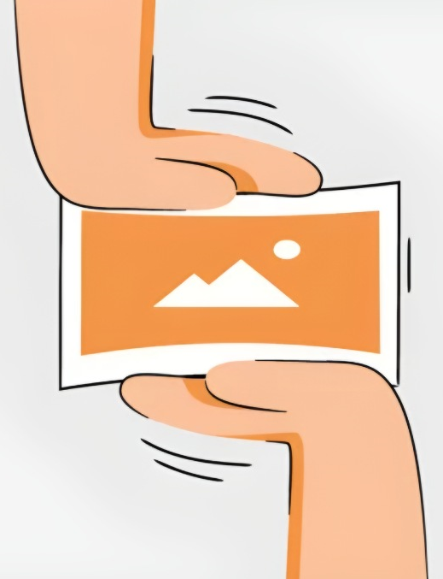
Photo Compression
Professor R. Ghaderi
Seyed Mohammad Sajadi

Slide 2

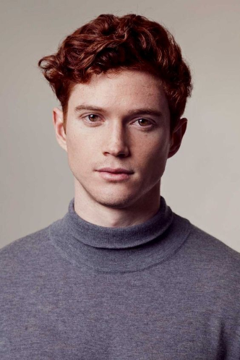
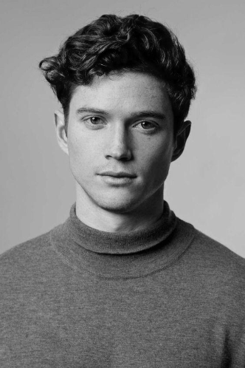
Photo preparation
Original img
to Gray img

Slide 3

The parameters for training
Max Iter
Hidden Layer Sizes
Test Size
Random State
5000
400,200
0.05
42

Slide 4

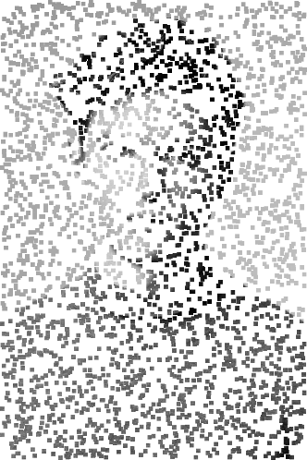
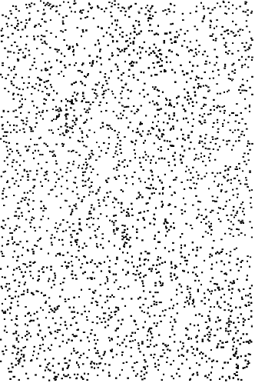
8x8 box
Compress img
Reconstructed with
neural network

Slide 5

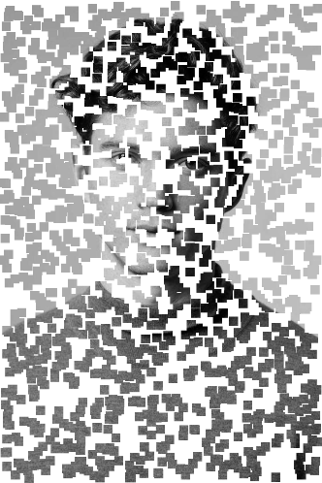
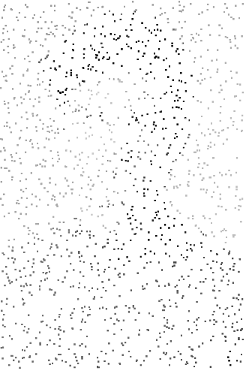
16x16 box
Compress img
Reconstructed with
neural network

Slide 6

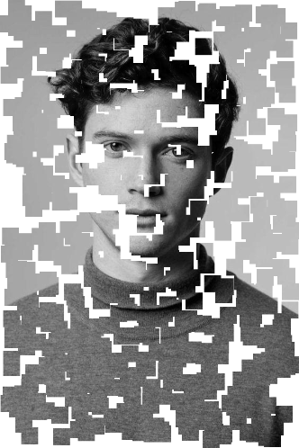
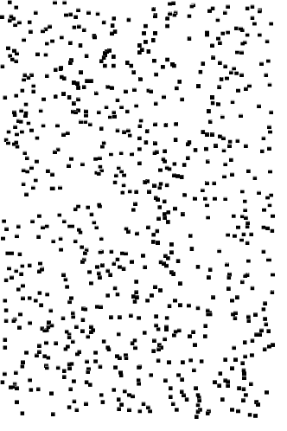
32x32 box
Compress img
Reconstructed with
neural network

Slide 7

Final Result
Framing
8 x 8
16 x 16
32 x 32
Smaller Framing
4 x 4
4 x 4
8 x 8
Samples Number
4000
2000
1000
PSNR (dB)
33.97
33.87
32.22

Slide 8

Thank for your patience

